Slide 1
Presentation on Anime store
Presented By:
-Ayush Pakhrin
-Robina Shahi

Slide 2
Table of Contents
Introduction
Problem statement
Objective
Scope and limitation
Development methodology
Requirement Analysis
Database schema design
Activity Diagram
Algorithm used
Implementation tools
Conclusion

Slide 3
Introduction
For starters, Anime is a style of animation originated in japan and has grown into a global phenomenon.Likewise E-commerce refers to buying and selling goods over internet
Hence we’ve built a website where collective figures and apparel to themed accessories are listed so that customers from any place can purchase an item through internet

Slide 4
Problem statement
On seller side, Anime merchandise seller face significant challenges in reaching target audience, managing inventory.
While On buyer side, anime fans struggle to find a reliable platform and personalization of merchandise.
This disconnects buyer and seller leading to unmet needs and limited opportunities for engagement.

Slide 5
Objectives
Provide a marketplace for sellers
Facilitate buyer-seller Interaction
Enhance User Experience for Customers
Monetization and Growth
Ensure platform Trust and Safety

Slide 6
Scope and limitations
Scope
Provide a dedicated platform for anime enthusiasts to browse and purchase anime merchs
Provide a seamless shopping experience and foster a community of anime fans.
Serve as a hub for anime fans while driving business success.
Limitations
Availability Issues
High inventory cost
Pricing competition
Lack of personalization

Slide 7
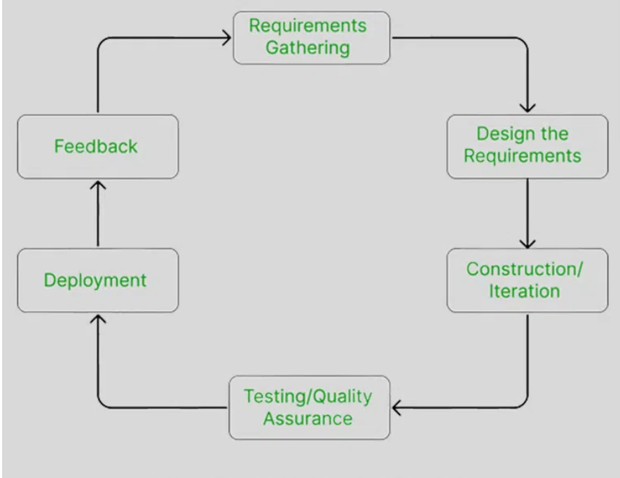
Development methodology
Agile methodology

Slide 8
Requirement analysis
Functional requirement
User Management
User registration and login
User profiles
Admin access
Product management
Product catalog
Product rating
Inventory management
Shopping features
Search and filtering
Shopping cart
Checkout process

Slide 9
Non-Functional requirement
Usability
Reliability
Scalability
Efficiency
Maintainability

Slide 10
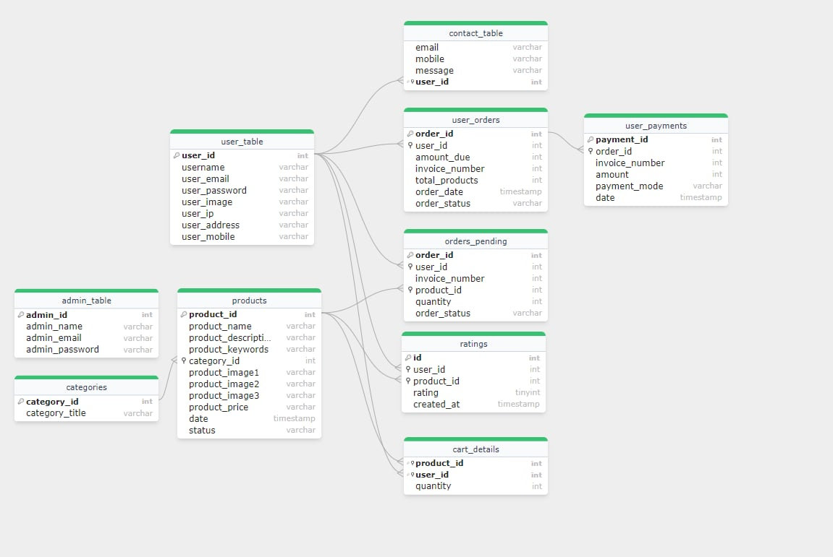
Database schema design

Slide 11
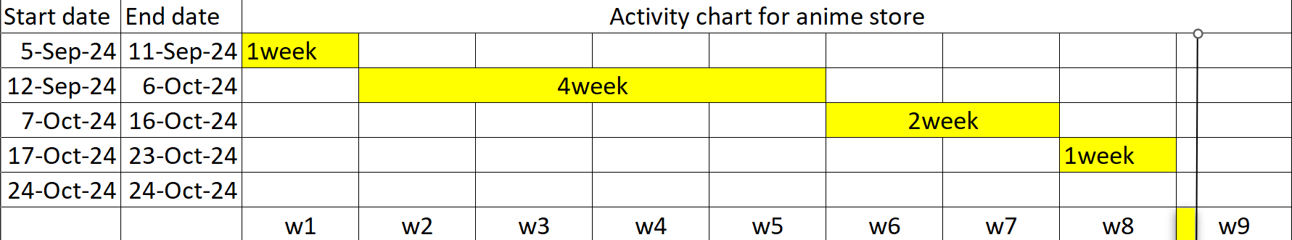
Activity Diagram

Slide 12
Algorithm used
Step 1: User rates the product
Step 2: Submit rated product in database and collect rating from database
Step 3: Calculate total ratings of the product
Step 4: Calculate the number of users that rated the product
Step 5: Using the rating of the product and number of users that rated the product we calculate the average rating
Step 6: Now we round up the ratings
Step 7: Lastly display the ratings on the product page
Step 8:Recommendation is based on the rating i.e highest rated product is displayed.

Slide 13
Implementation tools
Technology [Front-End]: HTML , CSS , BOOTSTRAP, JavaScript
Technology [Back-End]: PHP
Database:MySql
Code Editor: Visual studio code

Slide 14
Conclusion
The development of anime website has been a comprehensive journey , encompassing the design, implementation and testing phase.
In this project, We aimed for user friendly platform tailored for anime enthusiasts, offering a great browsing and purchasing experience
Moving forward, there is potential for further enhancement such as Adding coupon system and Recommendation of products using AI.

Slide 15
THANK YOU!!!!!

